Slide 1
HR Attrition ANALYSIS

Slide 2
TABLE OF CONTENTS
01
02
INTRODUCTION & DATA OVERVIEW
DATA CLEANING & EXPLORATION
03
04
DASHBOARD & ANALYSIS
RECOMMENDATIONS& CONCLUSION
Project Introduction
Dataset Description
Data Preparation
Key Data Insights
HR Metrics Overview
Bonus and Attrition Insight
Key Business Insights
Actionable Recommendations

Slide 3
01
INTRODUCTION & DATA OVERVIEW

Slide 4
INTRODUCTION
This HR data analysis project focuses on: identifying trends in employee performance, satisfaction, and attrition using historical HR data.
Data Sets Features:
Employee, Performance Rating, Education Level,
Rating Level, Satisfaction Level
The project goal: To provide insights that will help management improve employee retention and performance through data-driven decisions.

Slide 5
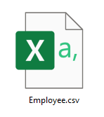
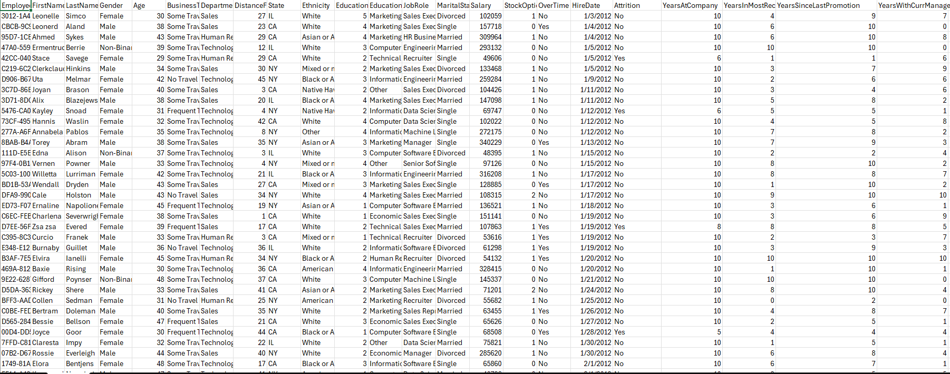
Raw Data Perview

Slide 6
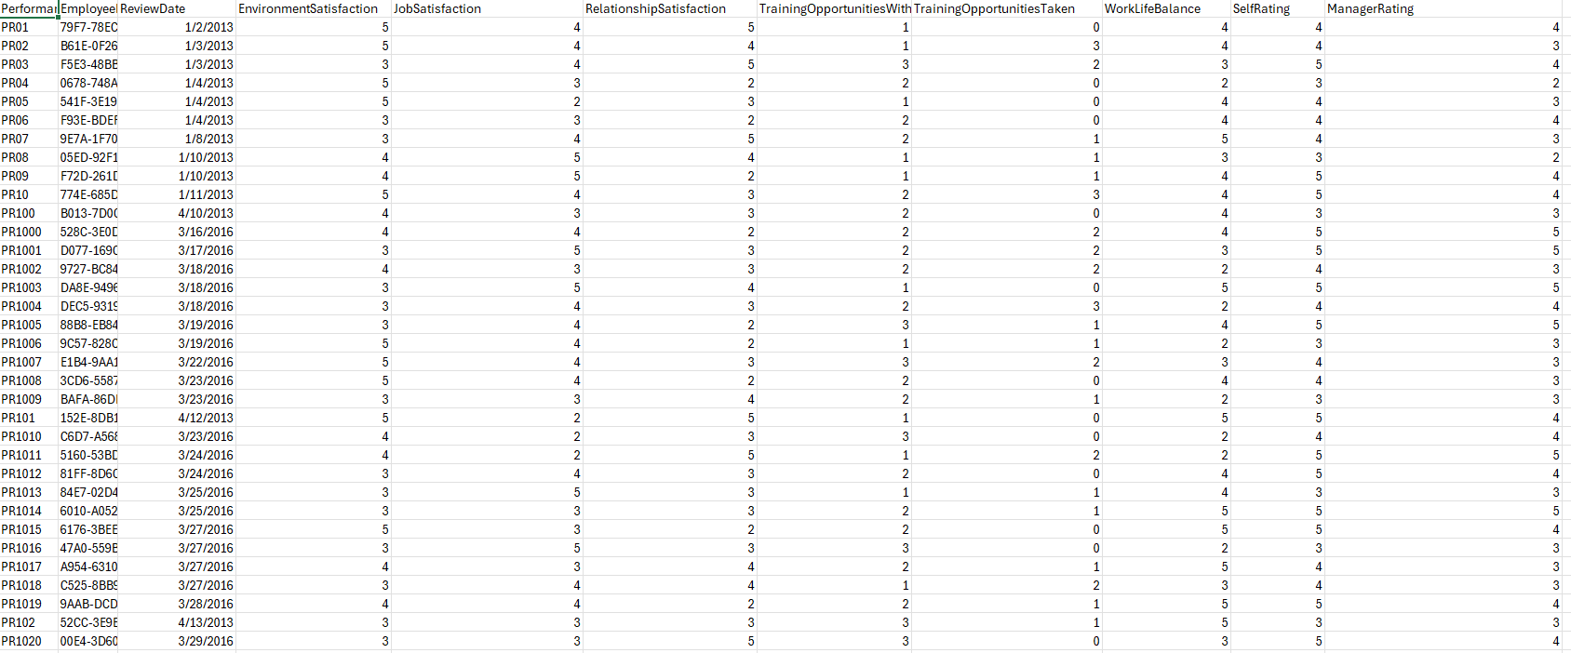
Raw Data Perview

Slide 7
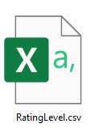
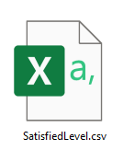
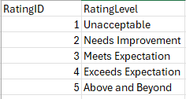
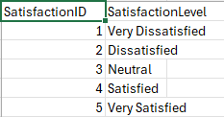

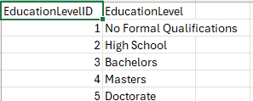
Raw Data Perview

Slide 8
Some of business Questions
Why are so many employees leaving the company?
What is the distribution of performance ratings across the organization?
How are bonuses distributed based on travel frequency and overtime?

Slide 9
02
DATA CLEANING & EXPLORATION

Slide 10
IMPORTED DATA INTO SQL SERVER
Data Exploration Process
Data Cleaning Process
Understanding the dataset's structure, distribution, and relationships
Removing duplicates, handling missing values, and ensuring proper data types

Slide 11
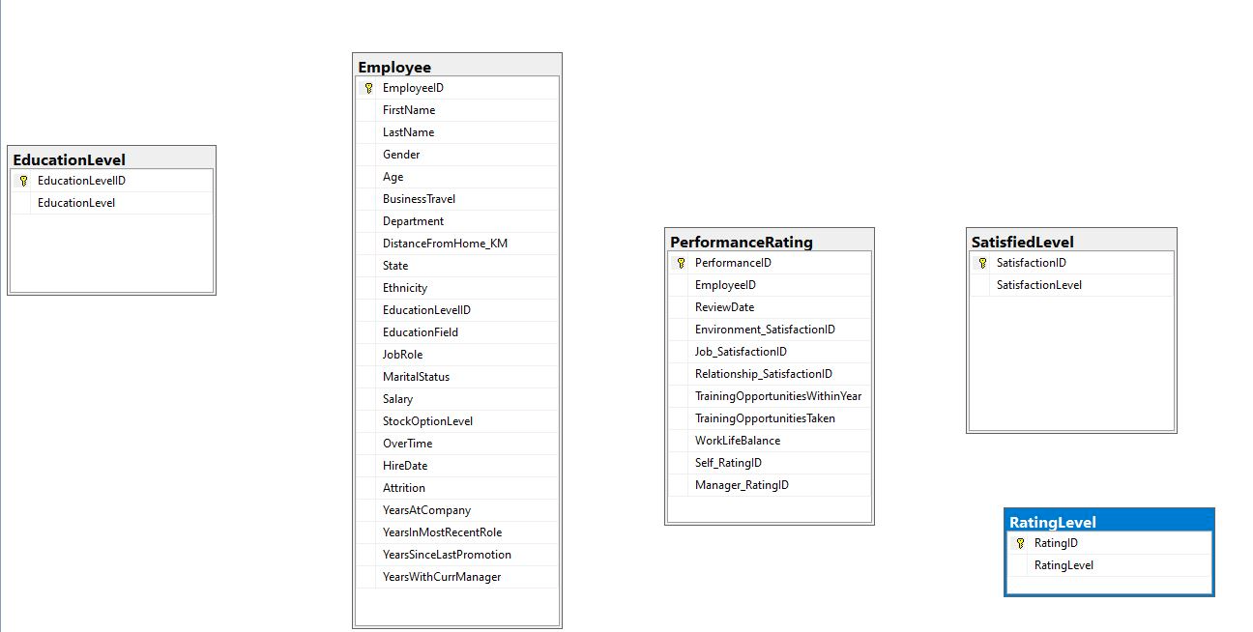
Raw Data Perview in SQL

Slide 12
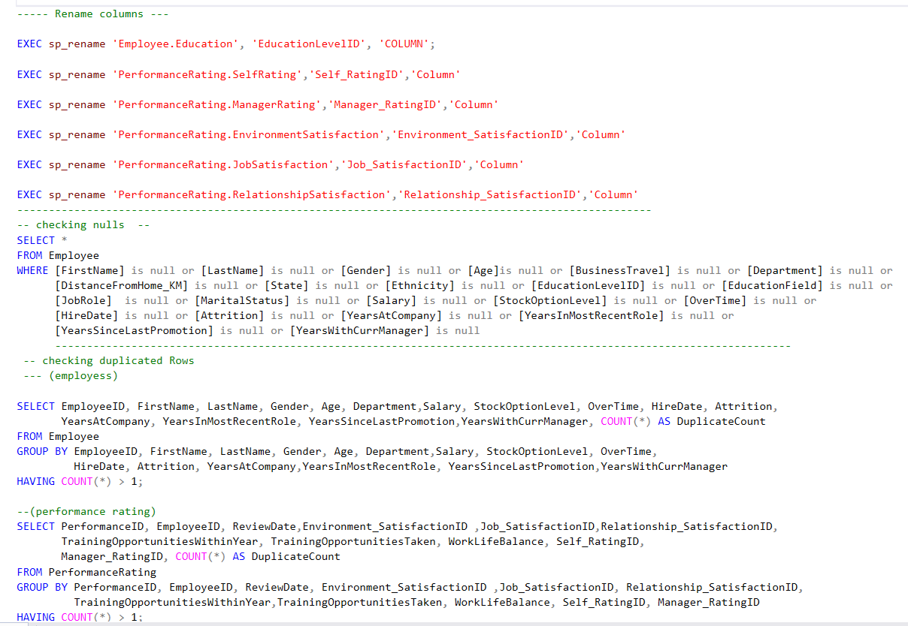
Renamed Columns & checking nulls & removing Duplicates

Slide 13
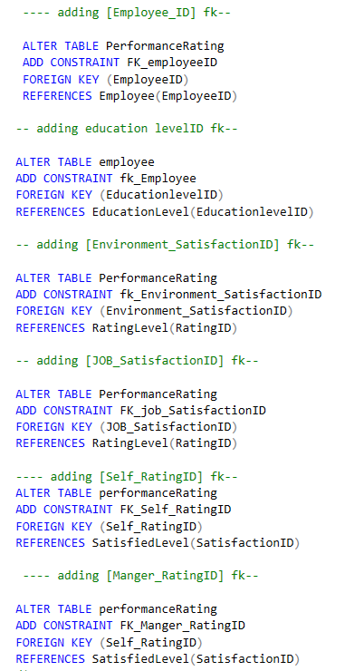
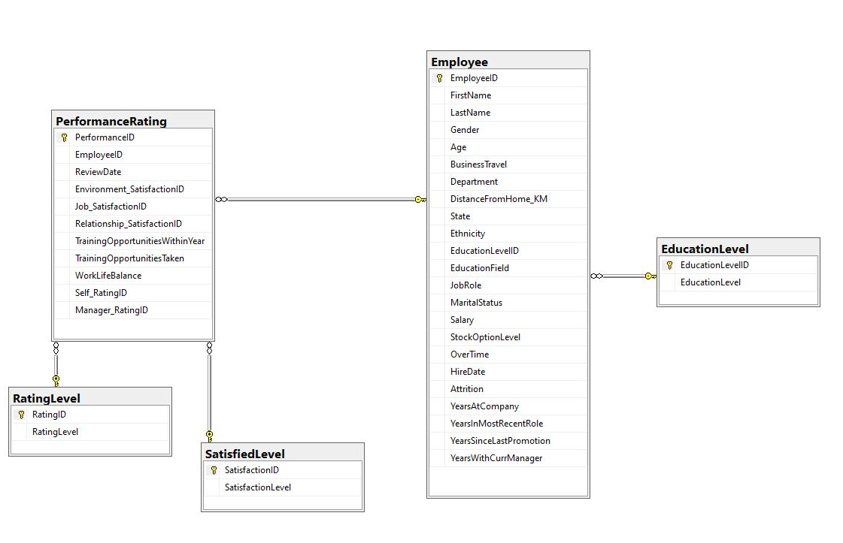
Adding FK ERD AFTER ADDING FK

Slide 14
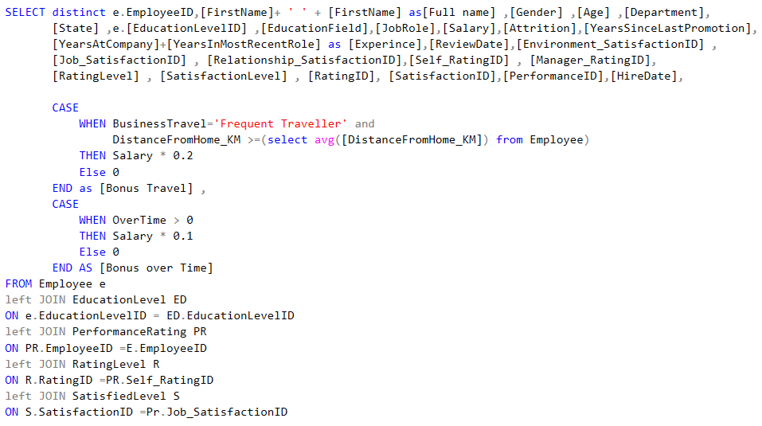
Write Select Query to Import it on Power Bi

Slide 15
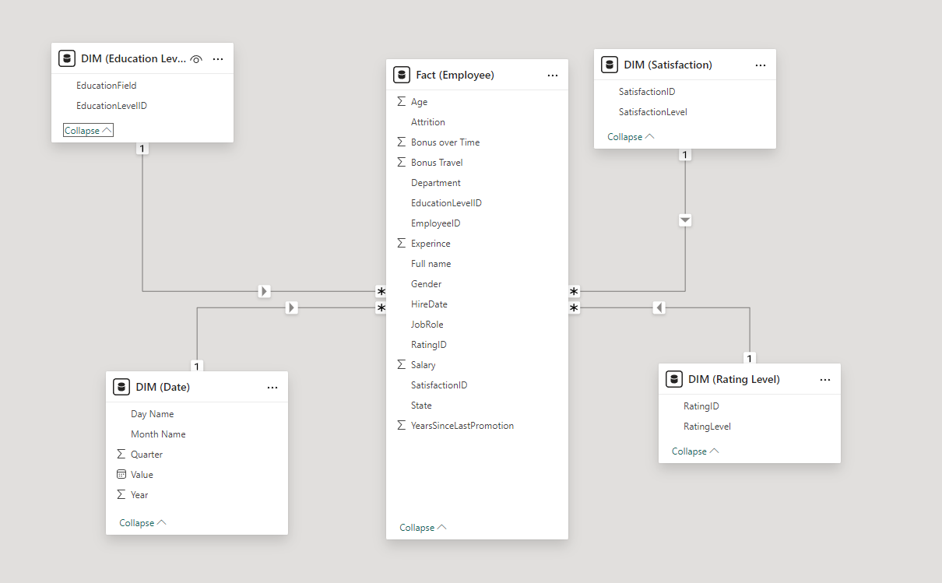
Making Star Schema using Power Query

Slide 16
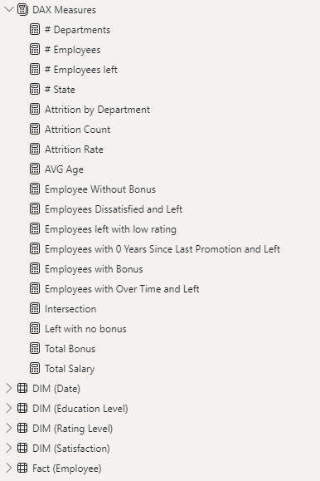
Measures By DAX

Slide 17
1233 out of 1470
Left the company Since 2012 but why ?

Slide 18
03
DASHBOARD & ANALYSIS

Slide 19
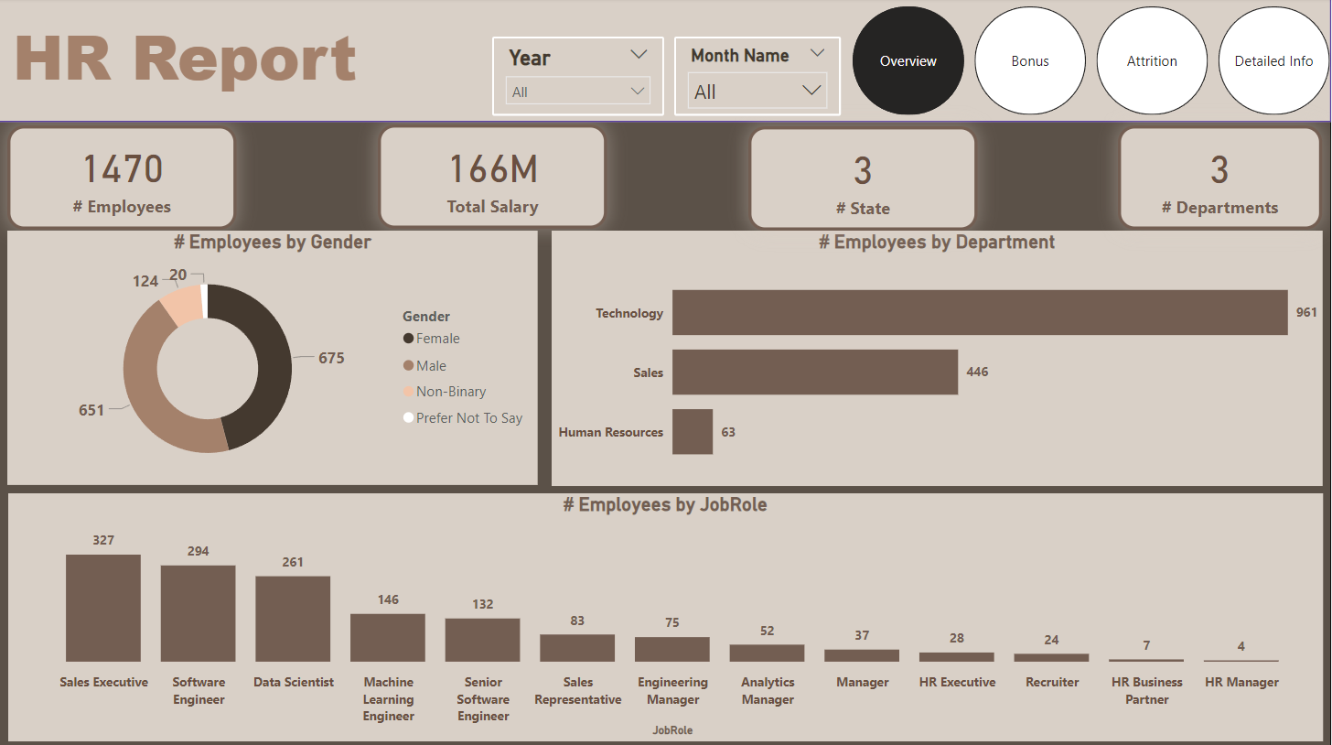

Slide 20
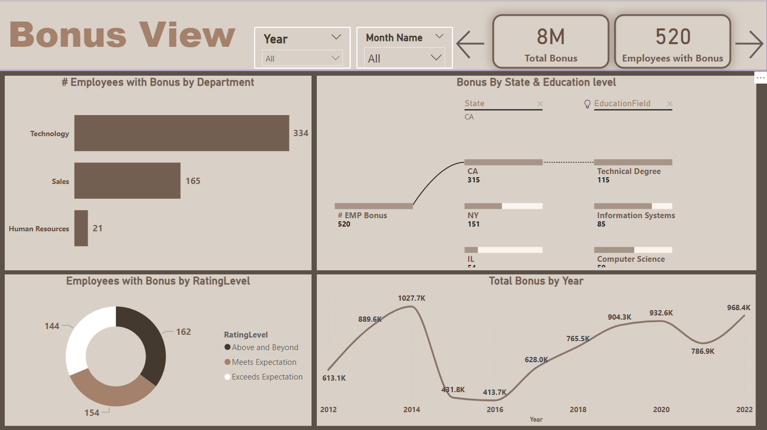

Slide 21
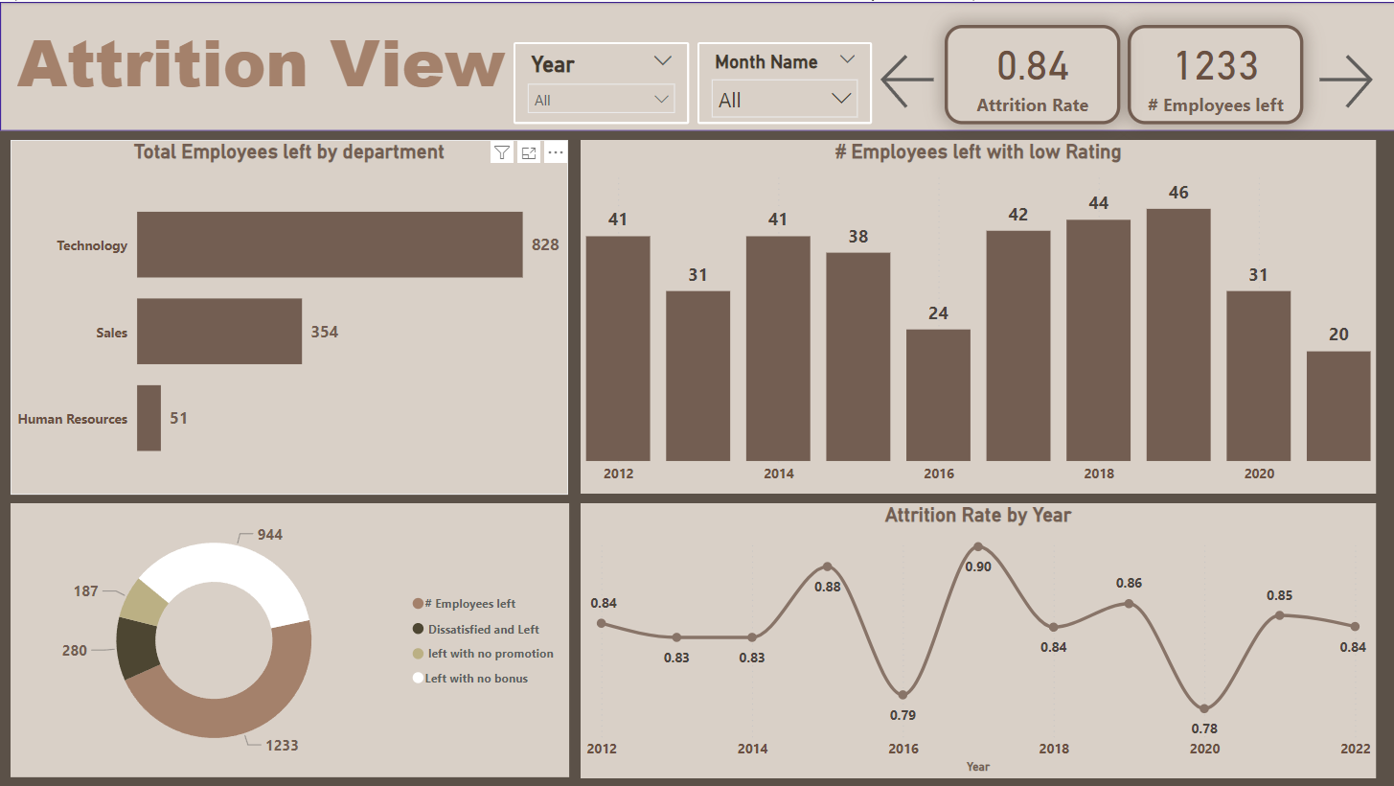

Slide 22
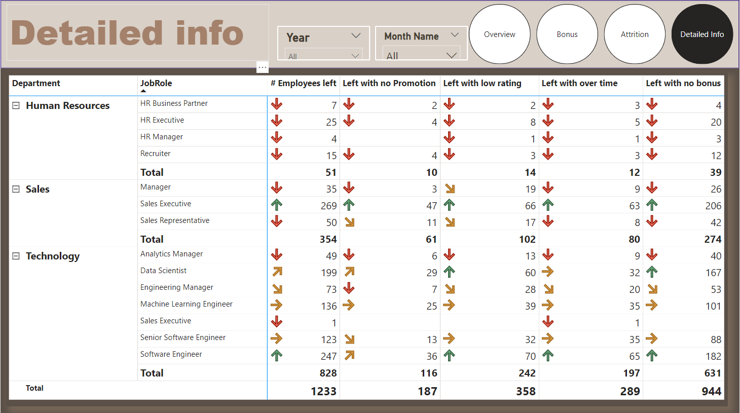

Slide 23
04
RECOMMENDATIONS & CONCLUSION

Slide 24
Key insights
20%+
Bonus & Distribution
Left Due to no Promotion
Travel frequency and overtime bonuses have a noticeable impact on retention, especially for employees who travel frequently or work overtime.
1st
2nd
3rd
4th
5th
50%+
Bonus & Attrition
Performance
& Satisifaction
Left Due to no bonus
Departments that received regular bonuses saw significantly lower attrition rates.
Many employees meet expectations, but job dissatisfaction and low environmental satisfaction are issues.

Slide 25
Recommedtions
Bonus Ploicy
Implement a structured bonus system tied to performance and retention, especially in departments with high attrition rates.
Promotion & Career Growth
Create clearer promotion pathways and offer promotion opportunities to reduce turnover.
Employee Satisfaction
Invest in employee satisfaction program like Training to reduce attrition

Slide 26
THANK YOU!
Do you have any questions?
fathysawan22@gmail.com

